Slide 1

BHARTI INFO TECH & SERVICES
(BITS)

Slide 2



About Us
BITs is a venture in the field of learning for arts, science and technology
We believe that effective learning come by doing not only by listening
We offers a series of model to explain the different theories so that one can learn, think and innovate their own

Slide 3



Our Objectives
To impart practical knowledge which in turn boost student’s confidence
Knowledge Enhancement and Skill Development among the students
To develop creative idea in human life
Notes:
<number>

Slide 4


Vision and Mission
We want to motivate individuals towards science and re-invent innovation in technology arena
To help students to improve their thinking ability and gain skills through our learning tools

Slide 5



How MindWorks?
It is not the text of that particular thing
What comes into your mind when you hear the word Agra
Our mind works in the form of image

Slide 6

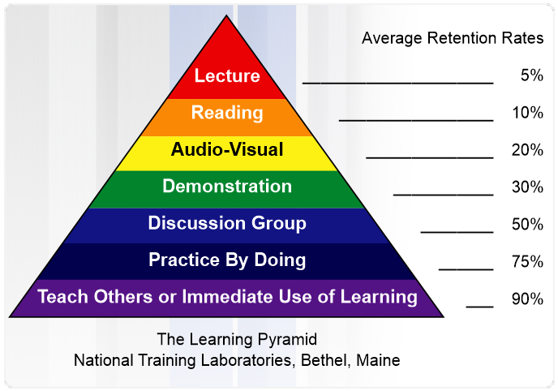
Problem Area
Present learning is equipped with organized but subjective material that limits student’s vision within the classroom boundary and emphasized on question/answer pattern of study
Audio – Visual even at its best have only 20% retention rate

Slide 7
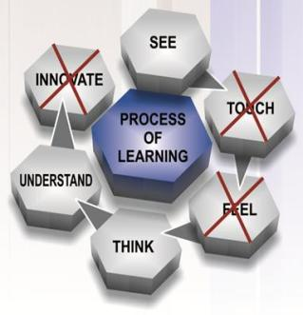
Present System of Learning
The modern smart classes are not smart enough, they are only limited to audio visual mode.
In smart classes, students can not touch the teaching tools and practical experience gets killed.
It becomes bore to hear some one for long time.
It kills students creativity, because students are now lost in smart phones.

Slide 8
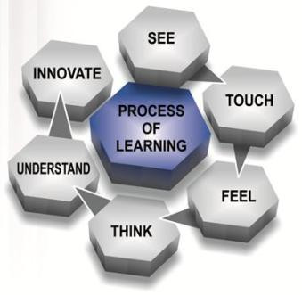
BITS System of Learning
“I hear and I forget. I see and I remember. I do and I understand.”
Demonstration
Working model
Live concept
General life science
Discussion
Interactive learning
Easy understanding
Solution finding
Practice by doing
Interesting learning
Creativity and innovation build-up
Real life problem solving skill

Slide 9
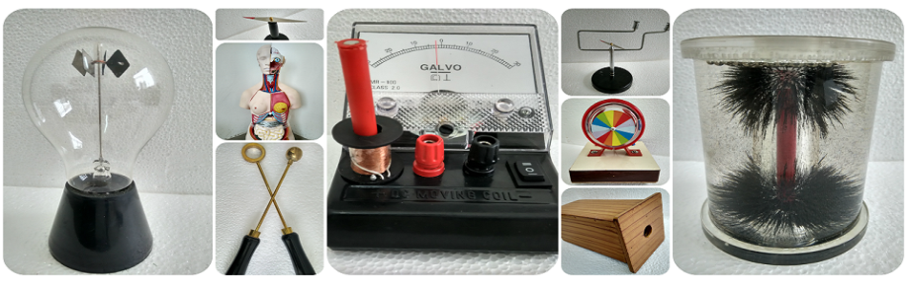

Our Product and Services
Practical Learning Environment
It builds student – teacher relationship and helps students to behave better in class and achieve at higher levels academically
Learning Center
We provide a tool kit to encourage students towards content of the class. It is student engaging, and well matched to the student’s skills

Slide 10
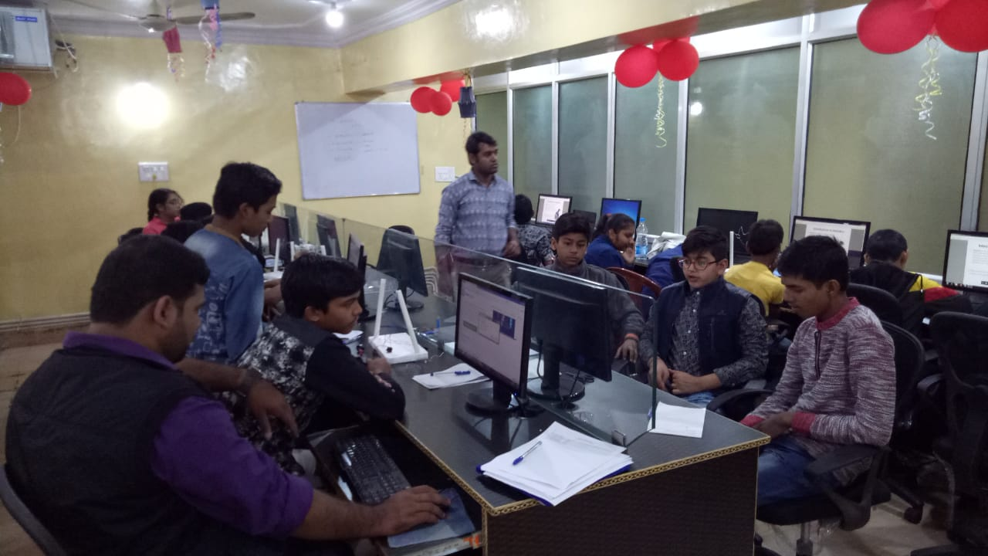
Our Learning Place

Slide 11


Our Product and Services
Sunday Activity School
It is open platform where one can participate to see, feel, touch, and understand the height of innovation so far from basics to latest trends
Workshop and Assessment Design
We design and organize workshops on science, robotics, math etc. to enhance the quality and understanding of learning

Slide 12




Practical Learning Environment
One Year Service A free one year service and up gradation of products
Teaching Tools
A set of teaching tools in the form of working model
Teachers Training Program
So that one can use our teaching tools with most efficient manner
Feedback
Feedback on every six months, to know the effectiveness of our tools

Slide 13




E-manual
This contains detail working of model, theory behind it and an explanation video
Product Chart
Proper categorization that shows which tool can be used in which chapter
Installation
Complete set of practical learning tools
Delivery
Delivery of products

Slide 14

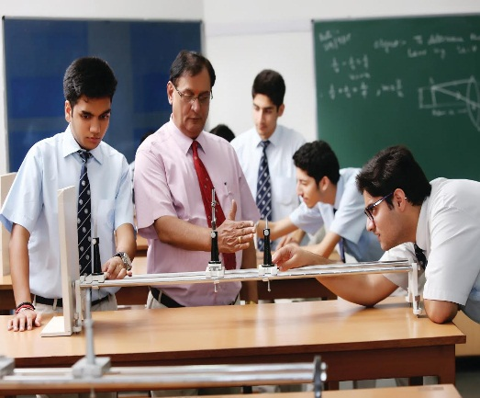
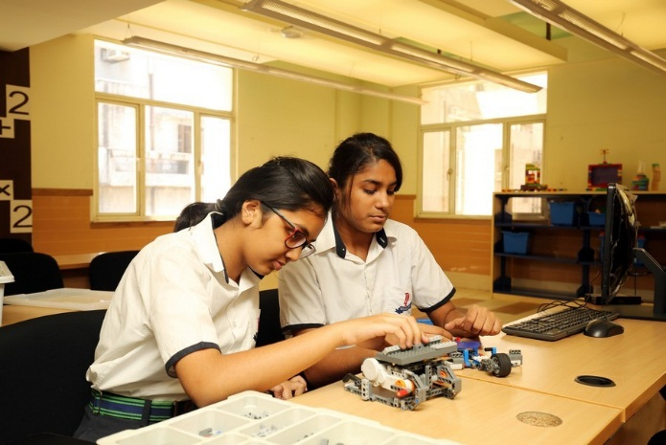
Science Activity School
Junior
Every Sunday Duration: 18 weeks Time: 1.5 hours 35+ experiments & projects All take way kits
Level 2
Every Sunday Duration: 22 weeks Time: 2 hours 40+ experiments & projects All take way kits
Level 1
Every Sunday Duration: 20 weeks Time: 2 hours 40+ experiments &
projects All take way kits

Slide 15
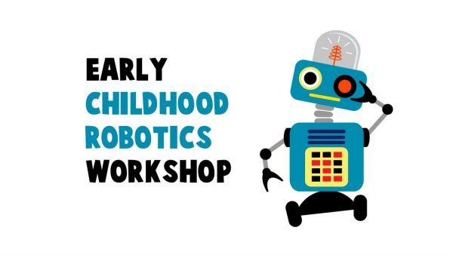
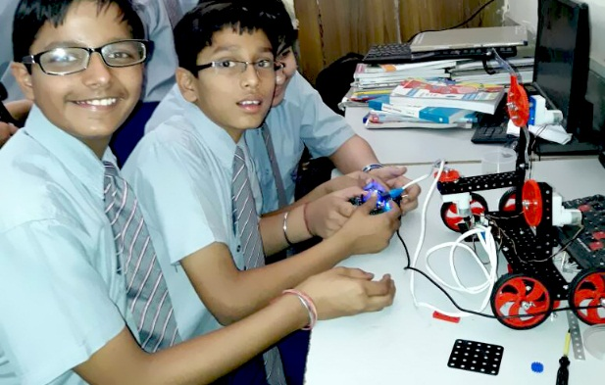
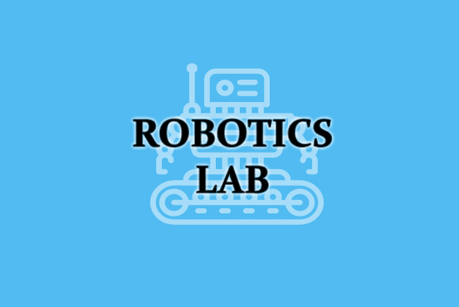
Robotics
12 to 16 hrs exhaustive hands on workshop on scientific theories and robotics to bring early hand on science and technology experience
Easy-to-use Robotics Education Curriculum that allows students to go from having no Robotics Experience, to programming advanced behaviors
Robotics lab setup powered by Robokidz Pune comprising robots which can be used in experiments by the students in a school environment

Slide 16
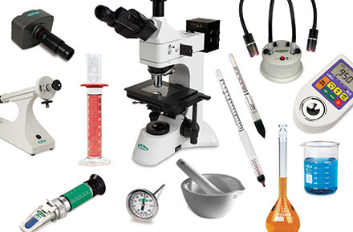


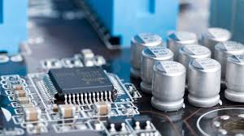



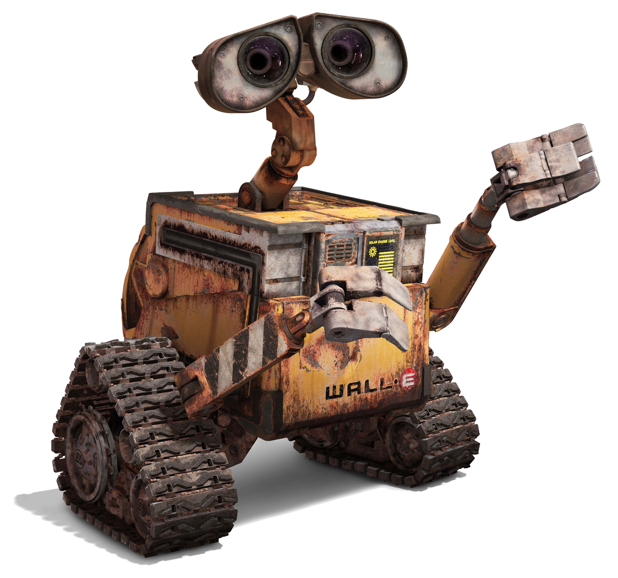
Other Services
Lab Item Supplier
Software Development
Web & App Design
Project Work
Industrial Training
Programming Languages
Digital Marketing
Robotics Automation

Slide 17
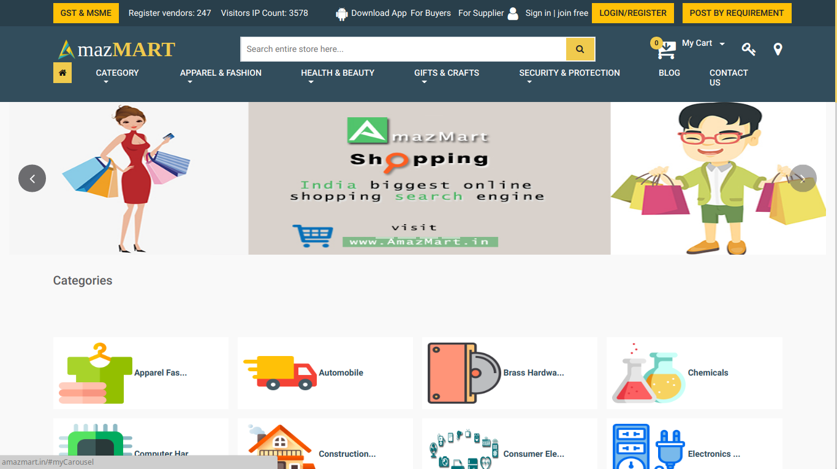
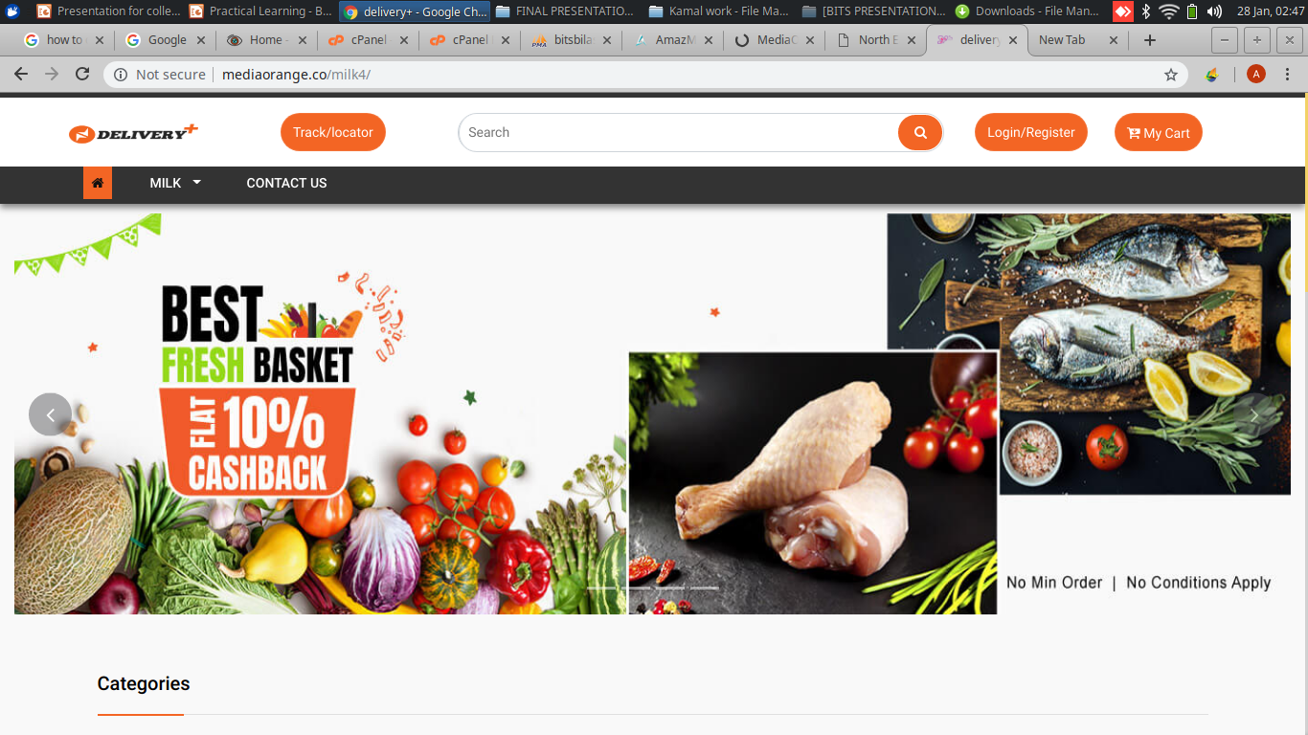
Clients
www.amazmart.in
www.deliveryplus.com

Slide 18
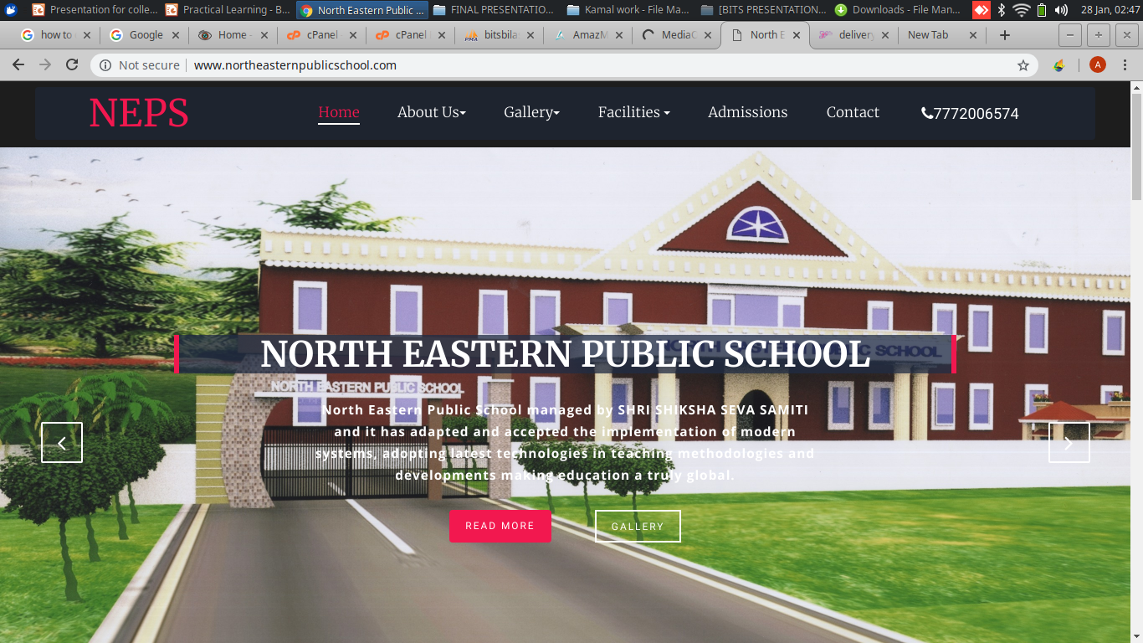
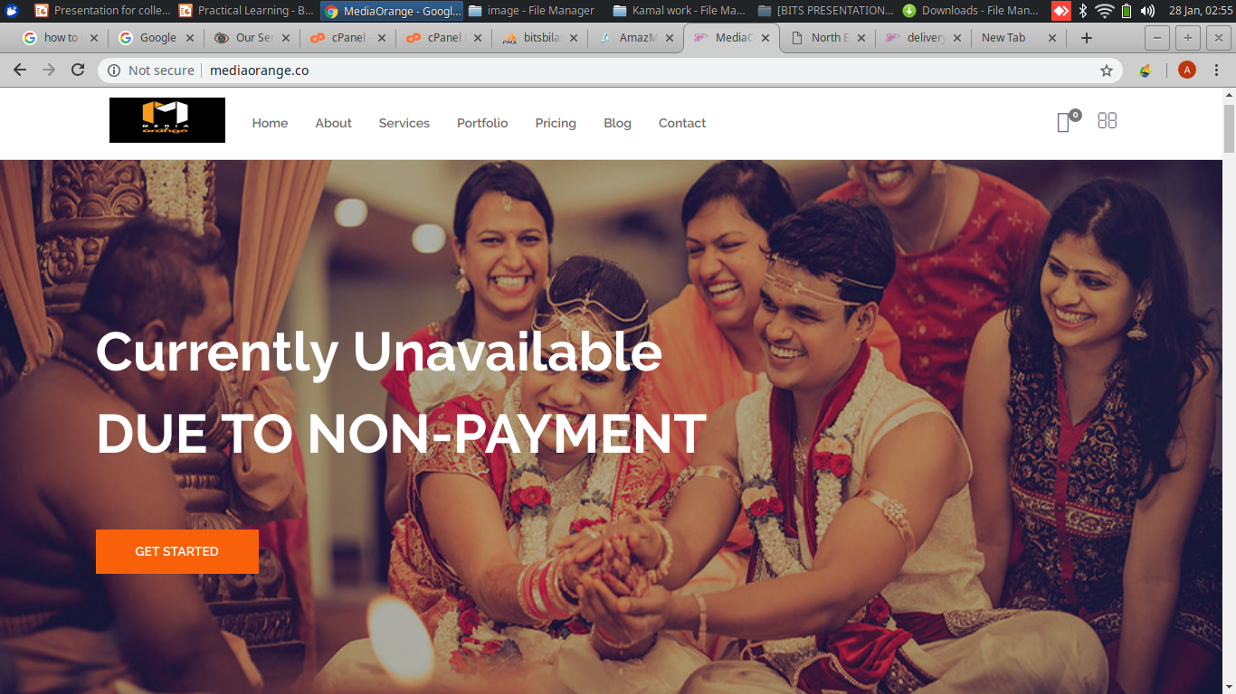
Clients
www.northeasternpublicschool.com
www.mediaorange.co

Slide 19
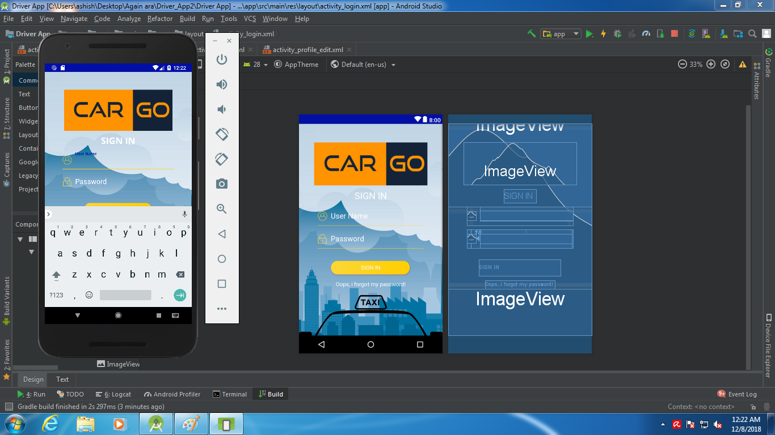
Clients

Slide 20
Clients

Slide 21
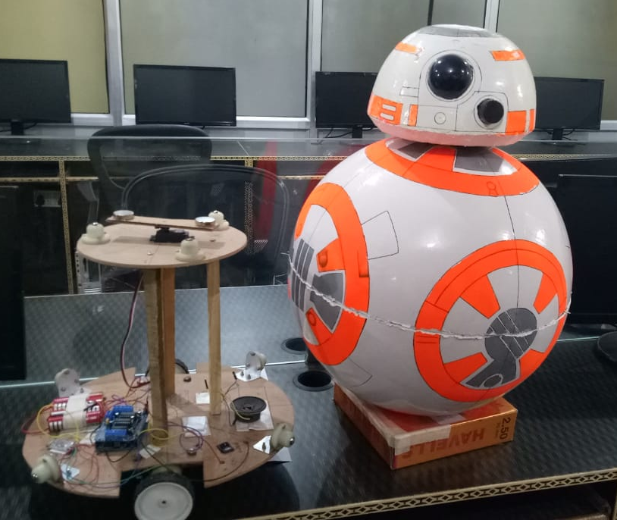
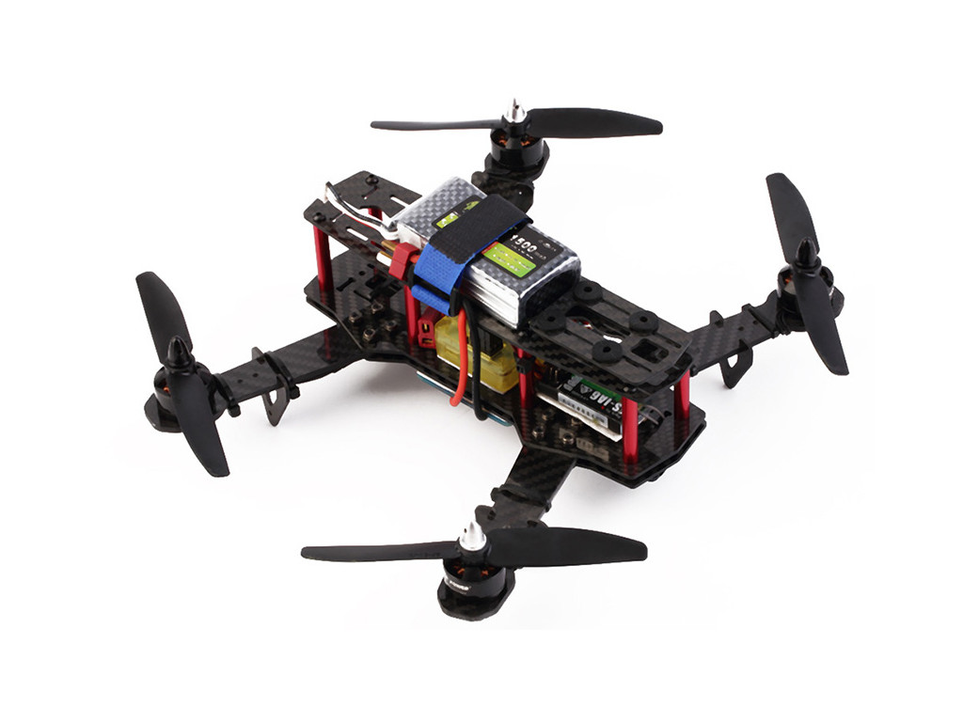
Projects
BB8 FROM STAR WARS
PROGRAMABLE DRONE

Slide 22
Projects

Slide 23
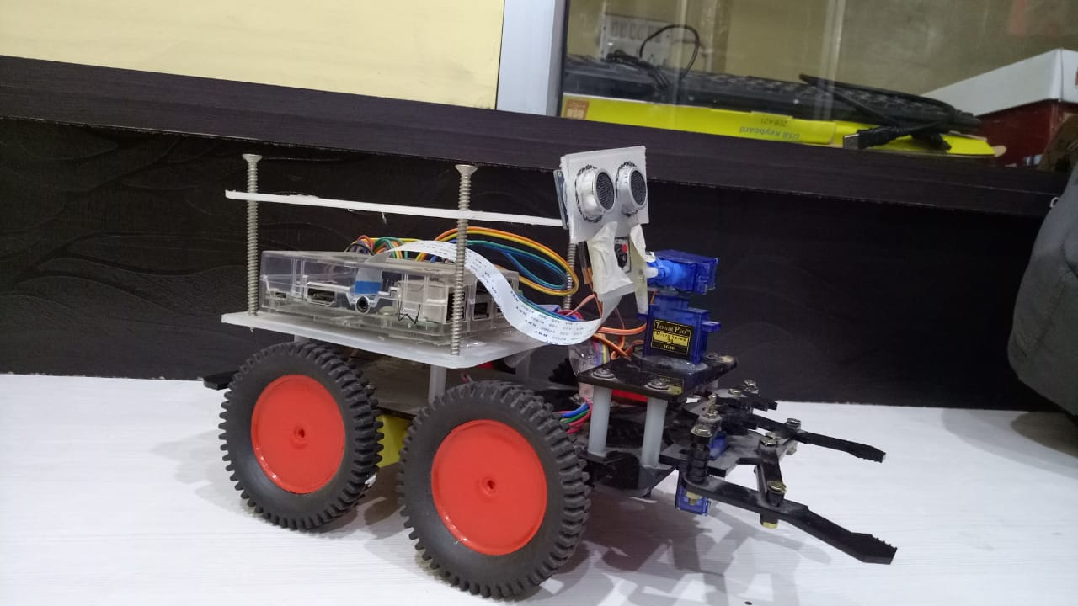
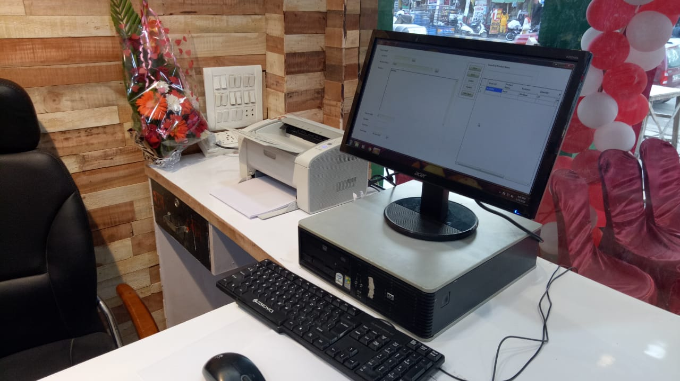
Projects
RASPBERY PI BASED ROVER
POINT OF SALE

Slide 24
Projects

Slide 25






Logo Design

Slide 26

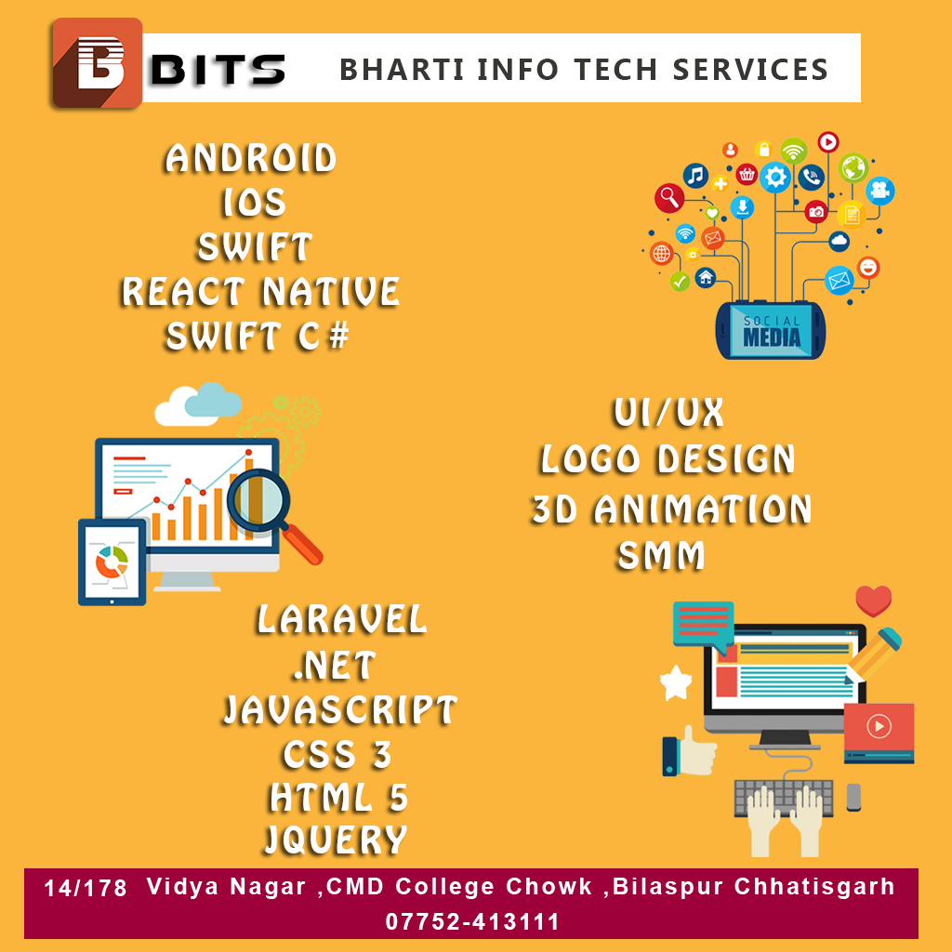
Tools

Slide 27
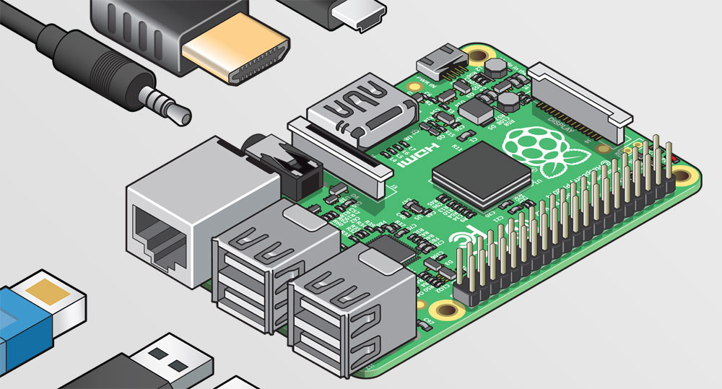
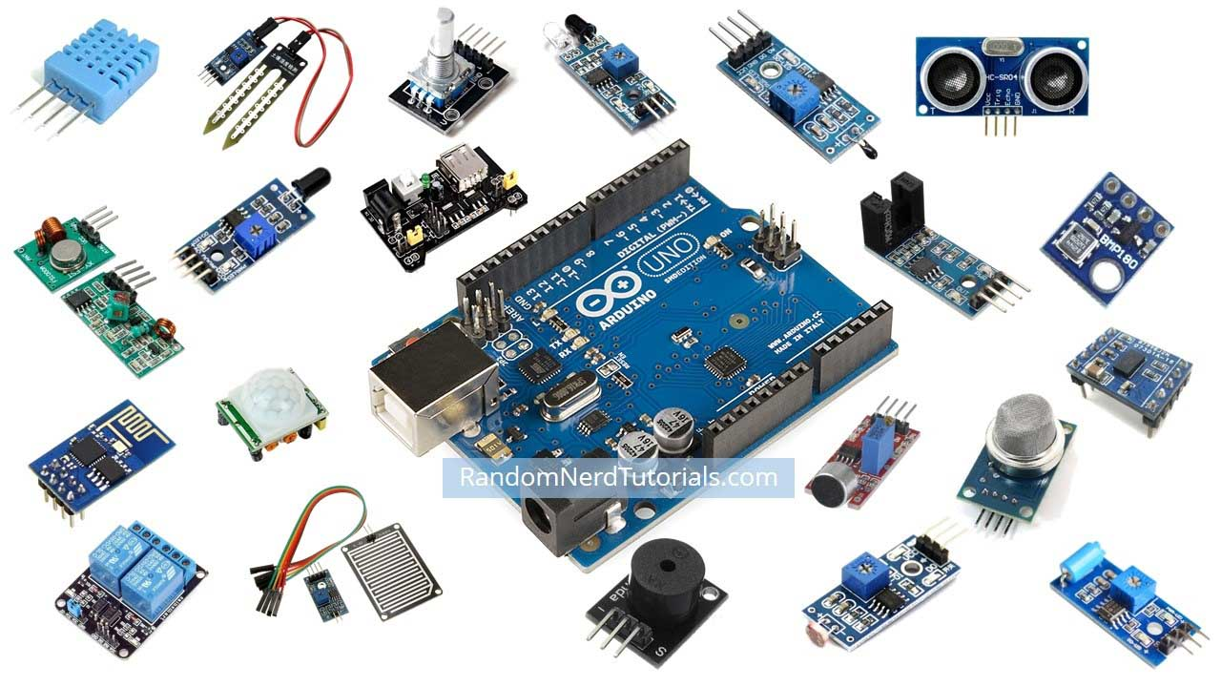
MicroController Boards

Slide 28









Languages

Slide 29

Latest Technology in Market

Slide 30
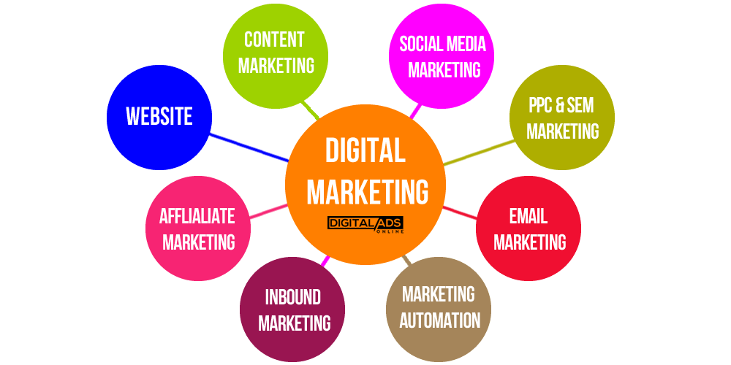
Latest Technology in Market

Slide 31
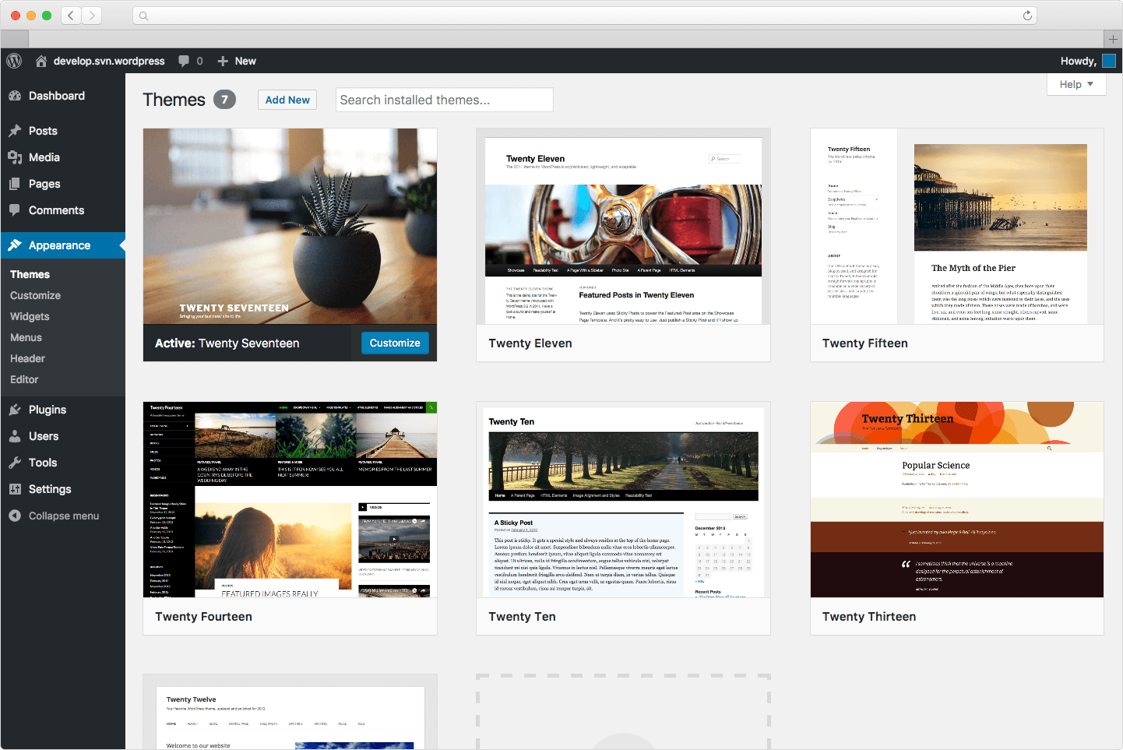

Latest Technology in Market

Slide 32
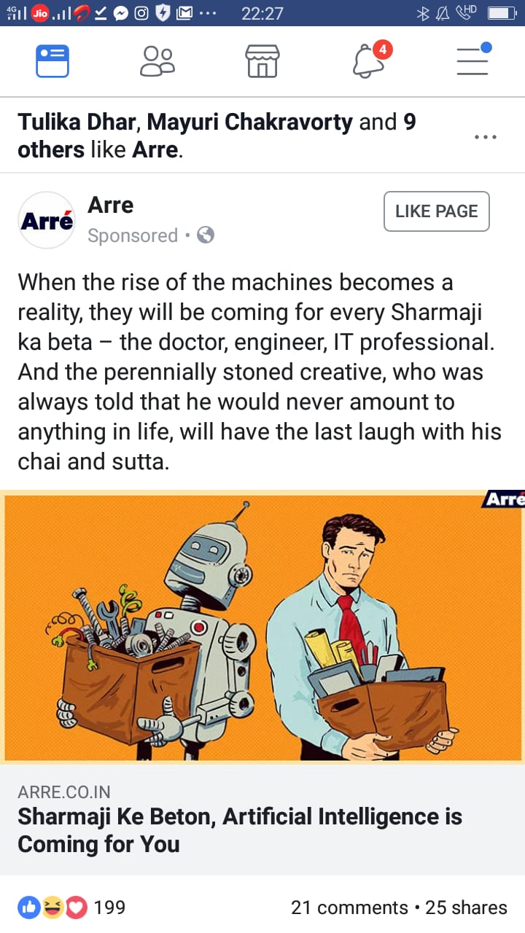
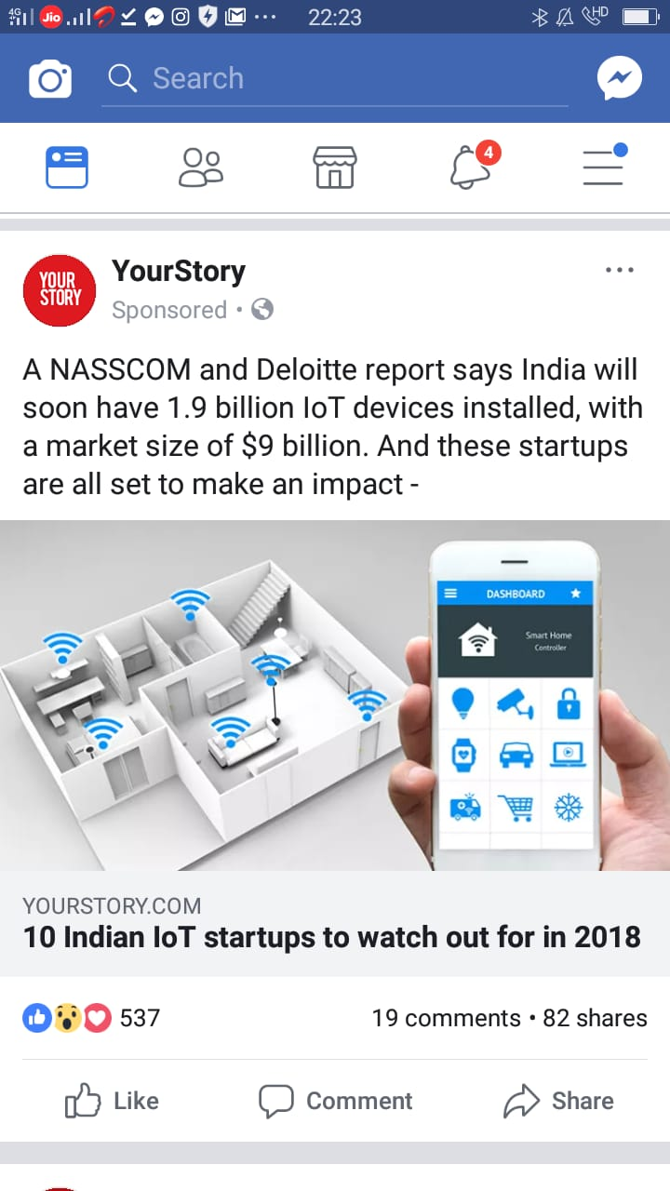
Why We Need This

Slide 33
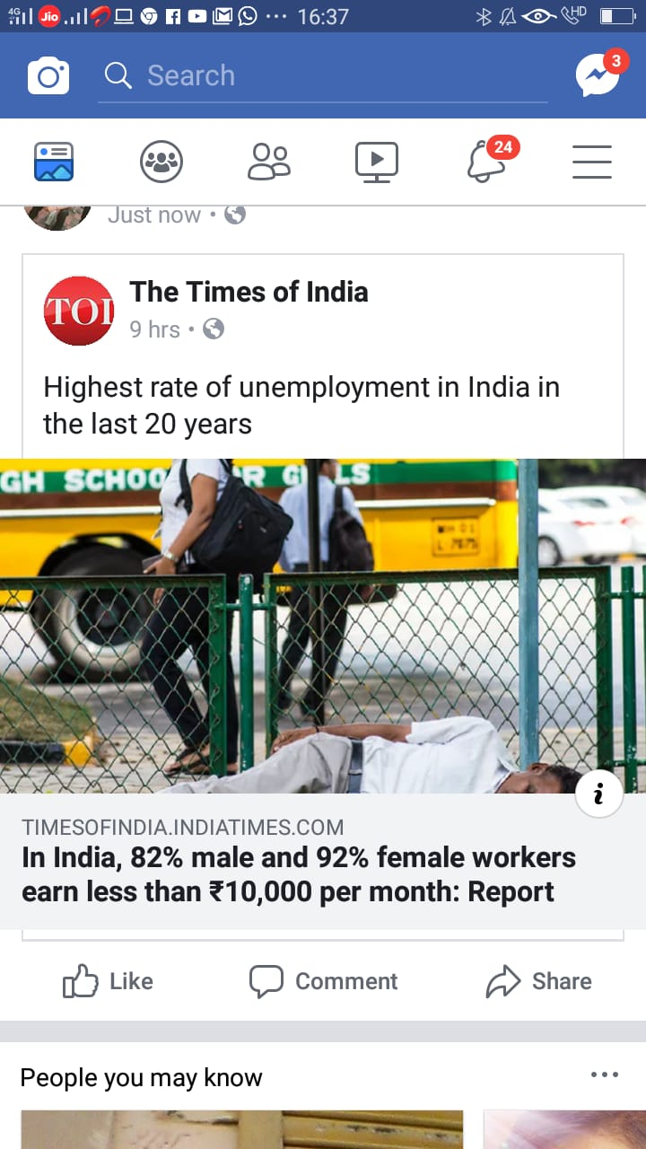
Why We Need This

Slide 34
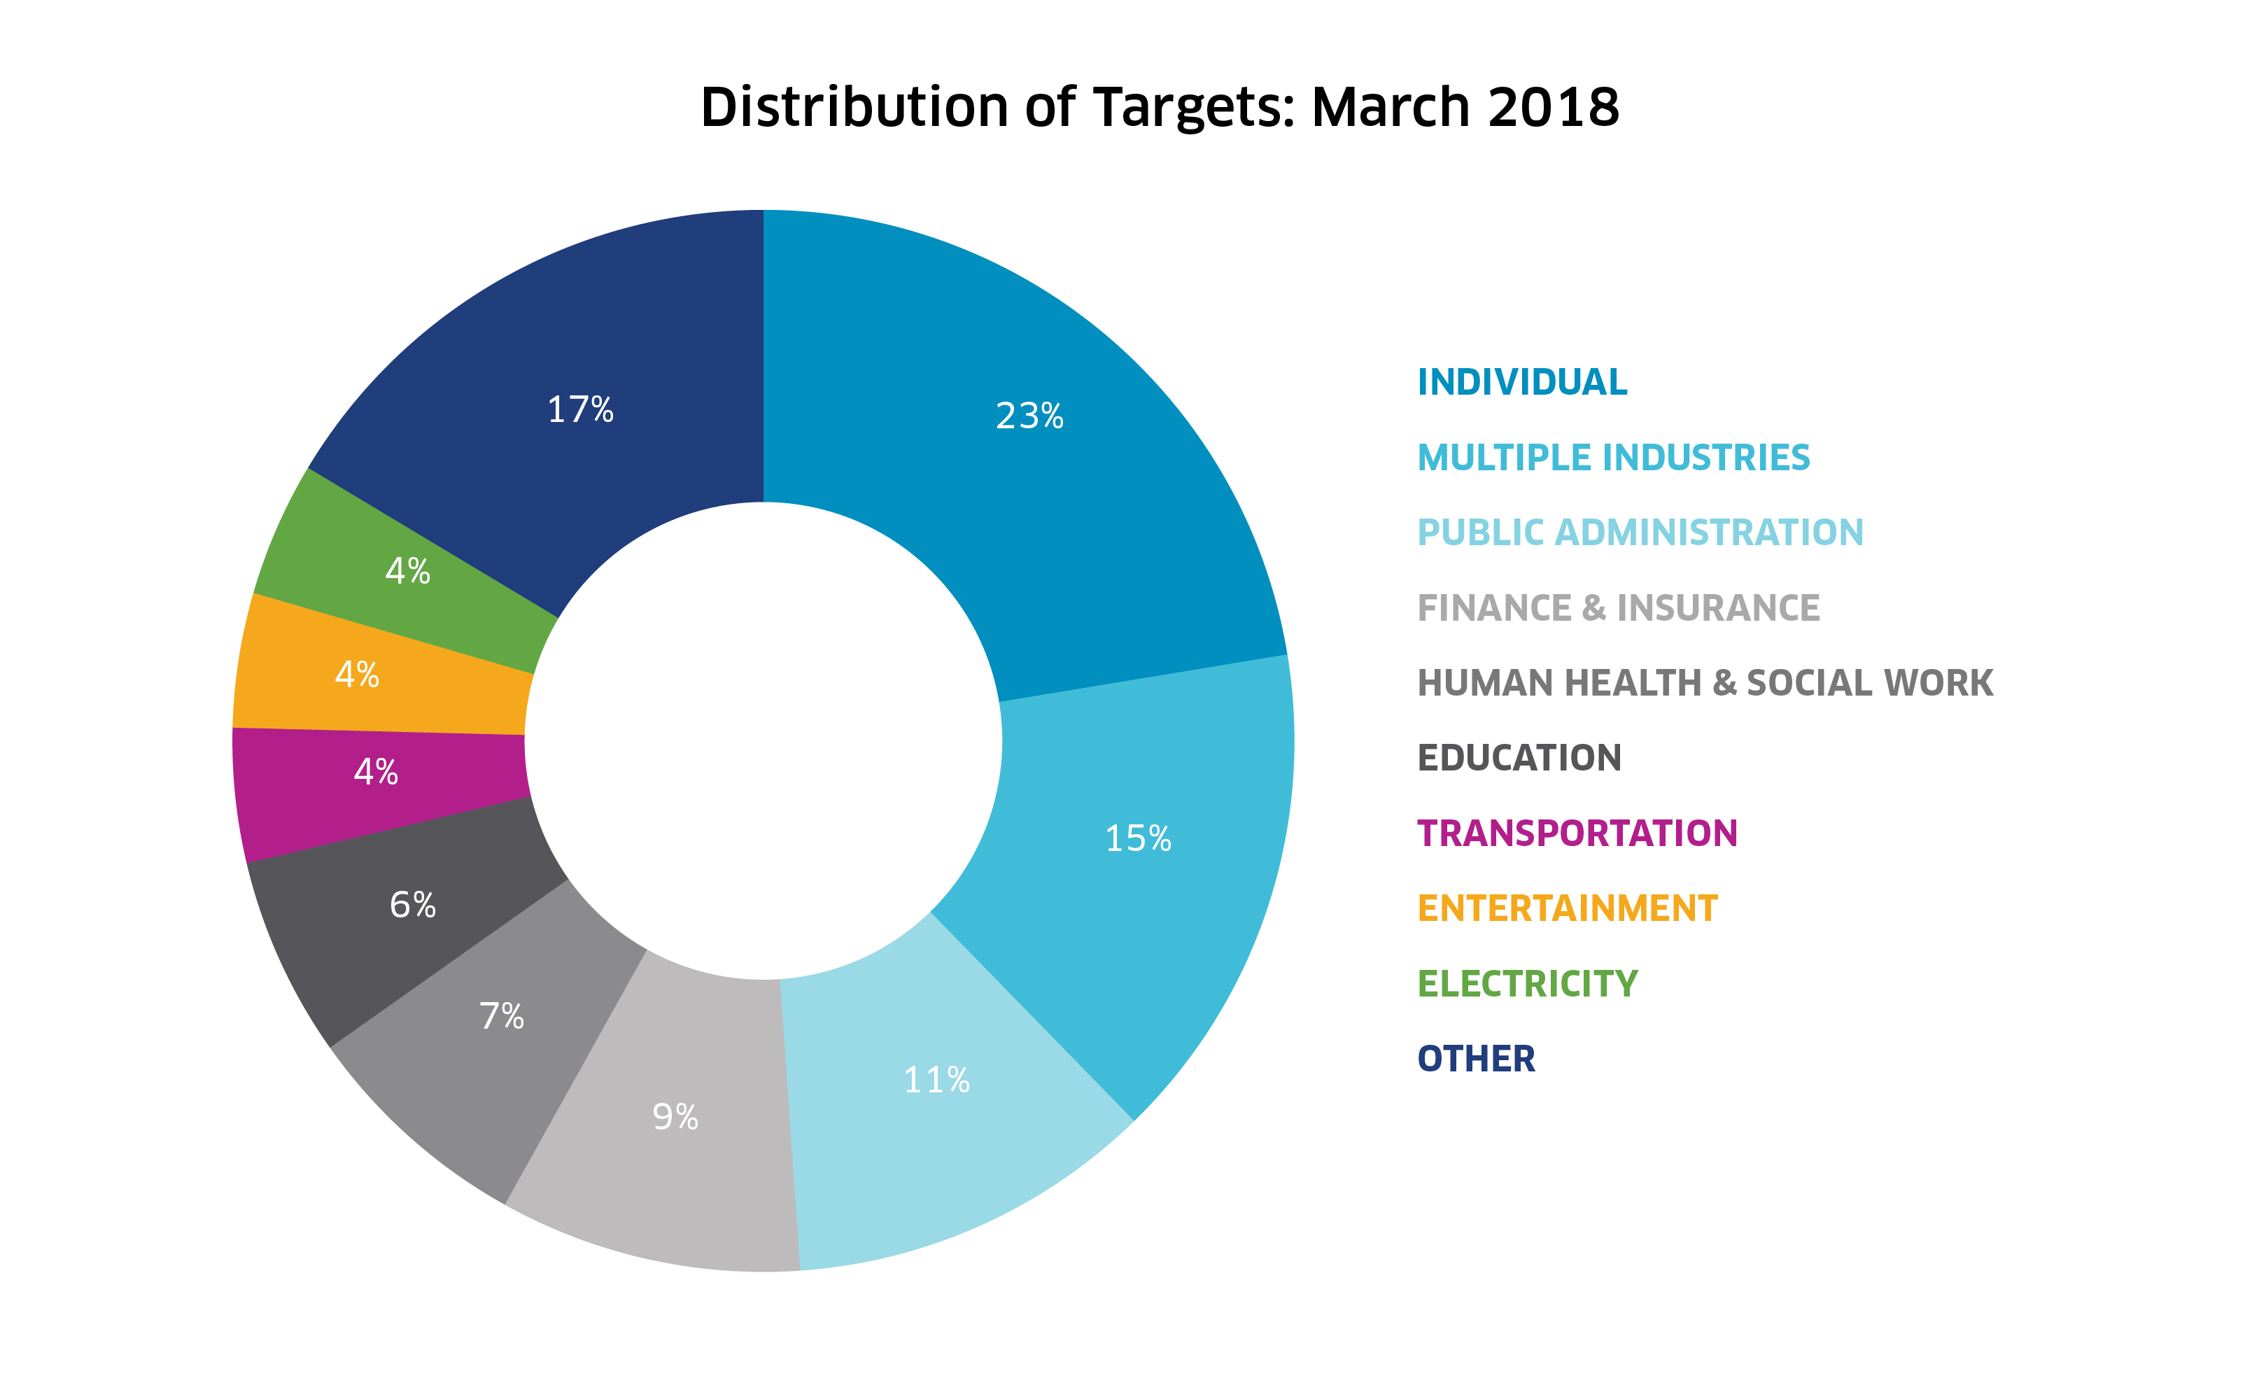

Slide 35
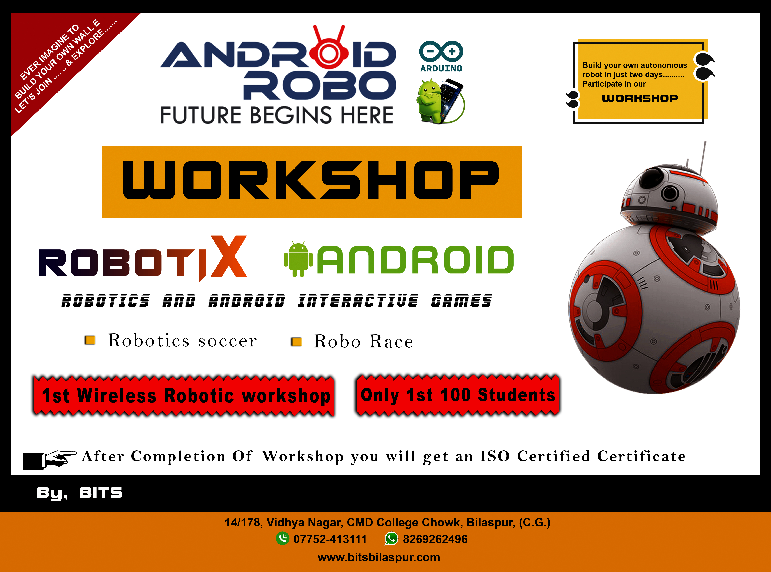

Slide 37

Queries ?

Slide 38
Thank You
Bharti Info Tech & Services
14/178, CMD Chowk
Bilaspur (CG)
07752 - 413111

